Slide 1
Elizabethtown College Wellness Center
Buck Kauffman, Jake Evans and Tommy James

Slide 2
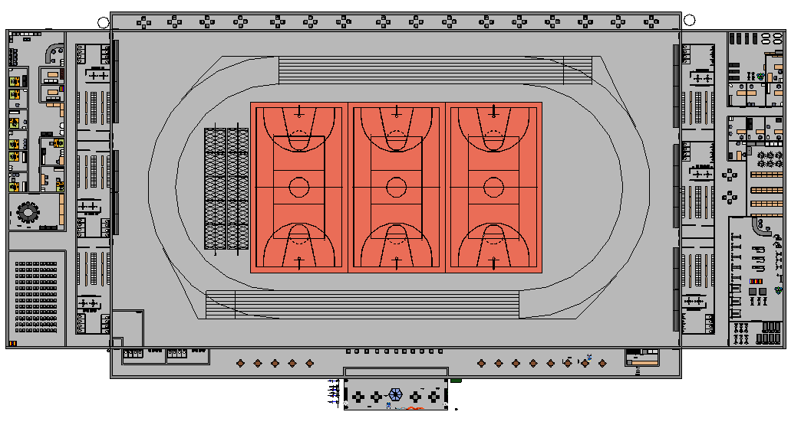
Design
Field room
NCAA indoor track
Batting cage
Basketball courts
Locker room
Fitness wing
Weight and Cardio room
Athletic offices
Training room
Storage room
Wellness wing
Counseling services
Classroom
Religious space
Large activity venue

Slide 3
Integration of Mind, Body, and Spirit
Counseling Services
Fitness facilities
Religious Space

Slide 4
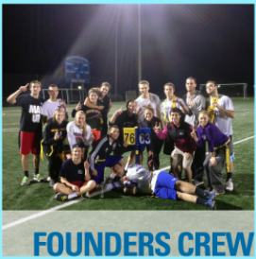
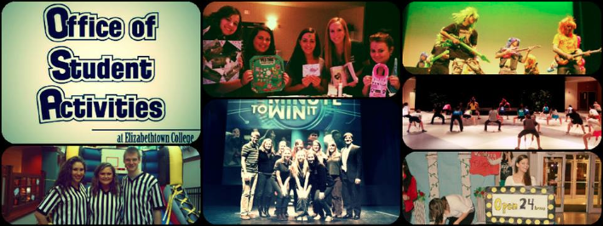
Promote Unity of Students, Faculty, and Staff
Intramurals
OSA events and activities

Slide 5
Promote Unity of Athletics, Academics, and Student Services
Classrooms
Fitness facilities
Counseling services

Slide 6
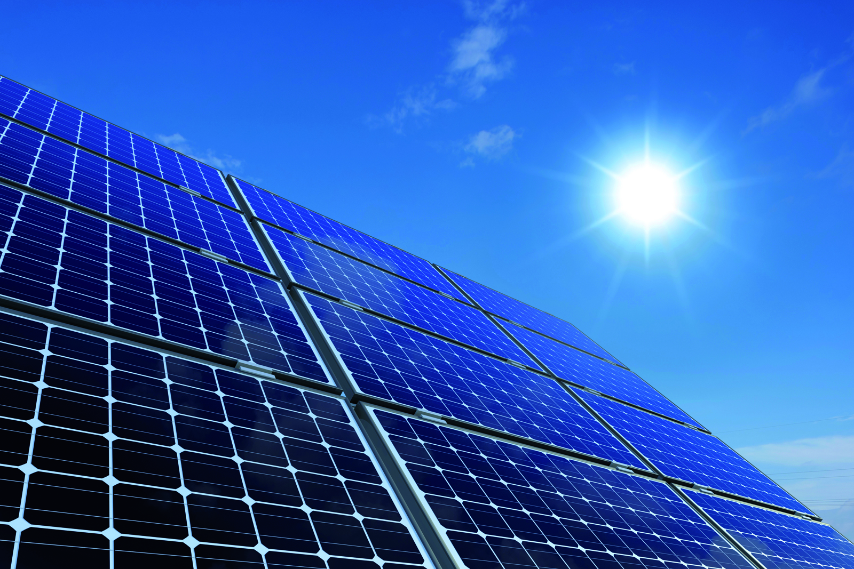
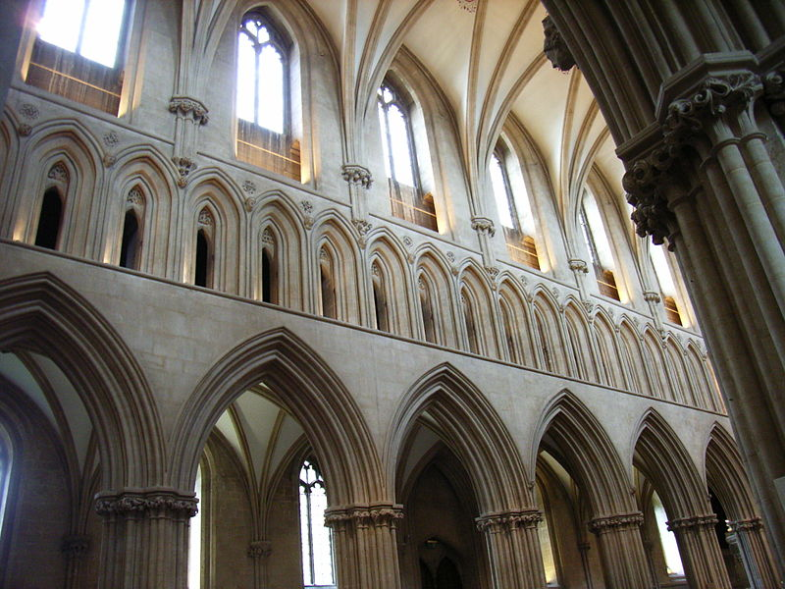
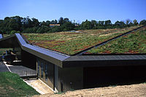
Sustainability
SOLAR PANELS
LARGE WINDOWS
GREEN ROOF
WATER COLLECTION

Slide 7
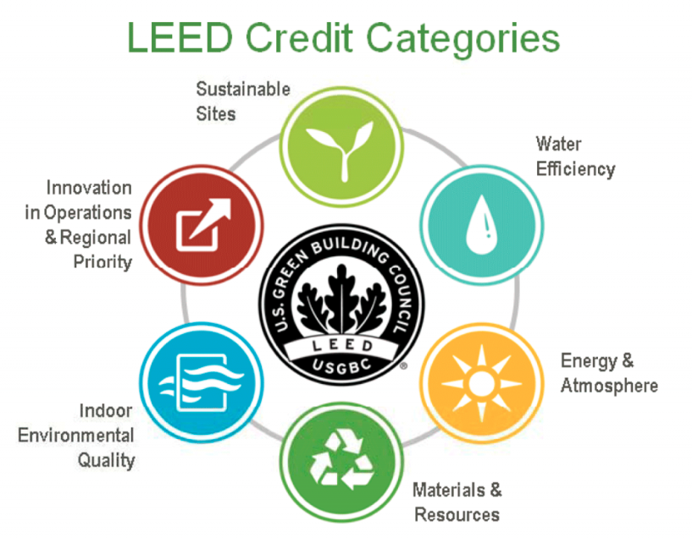
LEED Silver Certification

Slide 8
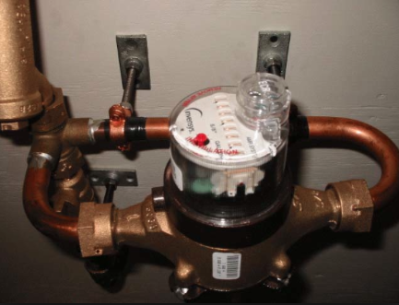
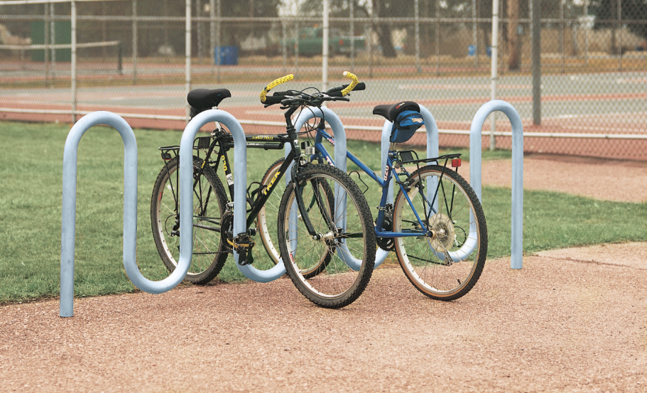
LEED Credits
Location and Transportation
Water Efficiency
Energy and Atmosphere

Slide 9
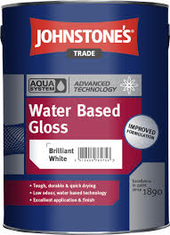
LEED Credits
Sustainable Sites
Materials and Resources
Indoor Environmental Quality

Slide 10
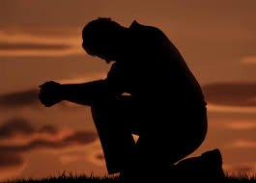
Wellness across cultures and beliefs
Nondenominational sacred spaces
Large Activity Venue
Meeting room

Slide 11
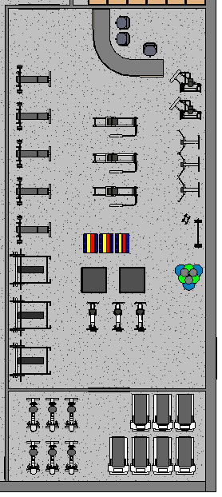
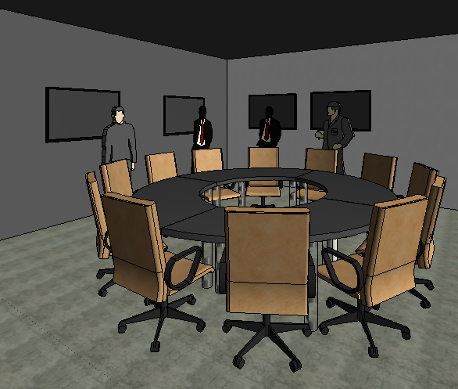
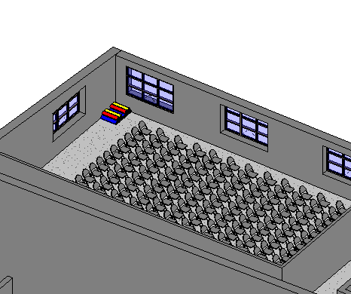
Community Involvement
Field Room
Large Activity Venue
Weight and Cardio room
Meeting rooms

Slide 12
QUESTIONS???
For references see paper

